Slide 1
Telling your story
Presented by Dominique Thurlow and Danielle Lorberbaum

Slide 2
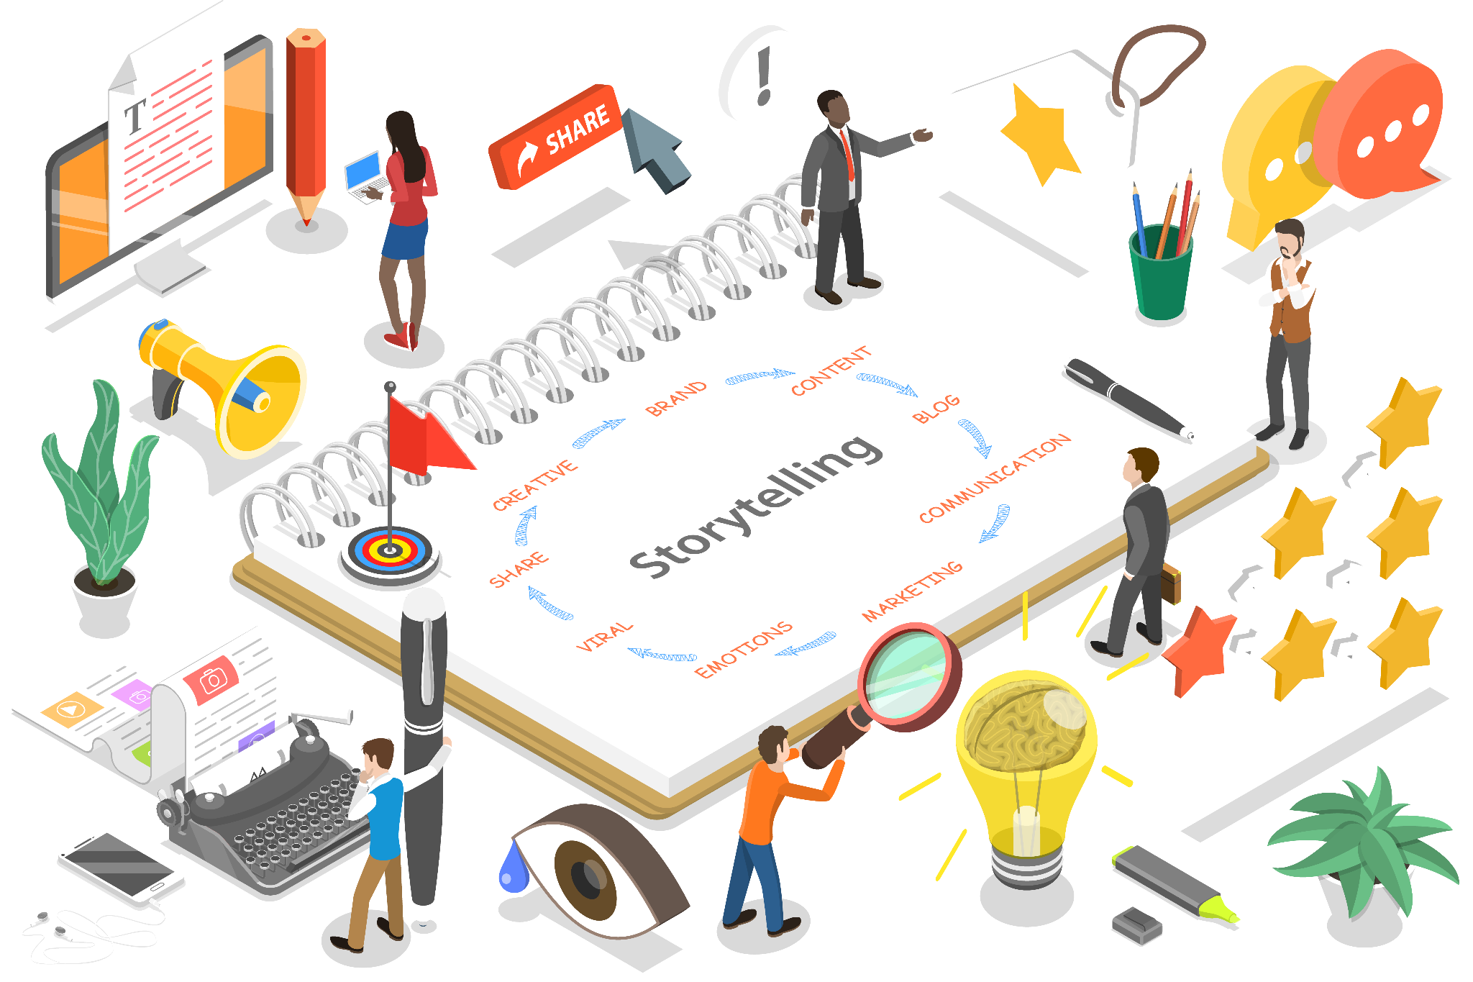
How do you tell your story?
Notes:
Lets just say I’m a Community Organisation, Registered Charitable Trust. My Trust has this wonderful idea that it wants to set up a Community Hub, a place where our communities can come for a variety of different programmes. Great initiative which will bring the various of sporting clubs, our community hall , te reo classes all together in one central place. I know that this is going to require lots of conversations with different stakeholders, but firstly, I need to bring these stakeholders on the journey, So my Trust needs to be able to tell its story, which is what we’re going to unpack today.
Dom - When it comes to telling your story I would like you to think of the last time you were trying to explain to a friend or family member what your nonprofit does. Now, think of a time you had this same conversation, but at an event with potential donors or supporters.
Did you struggle to describe your organization in a clear, compelling way for each group? Or, were your descriptions exactly the same (when speaking to very different audiences)?
Would your co-workers have used language or descriptions very different from yours?
Building a key message framework and socializing it across your organization can help every member of your nonprofit’s team and board feel confident that they’re positioning your nonprofit in the best light possible no matter who they’re talking to — from donors and supporters, to the media, to those who use your organization’s programs and services.
Key messages are the main points you need your stakeholders to hear, understand and remember about your organization.
They create meaning behind the work you do, the issues you want to discuss and the actions you want people to take as you work to advance your mission.
Key messages encourage consistency, which leads to resonance. The more consistent your staff and board are in how they communicate about your organization, the more easily people will come to understand and want to get involved with your organization, whether as donors and supporters, or program participants.
Today we want to help you understand who you are and what you’re about and be able to articulate that to your communities in a way that reaches the hearts and minds of your community.

Slide 3
Define your story
Who are you?
What do you do?
What’s your vision?
What are your goals and aspirations?
Notes:
Before you start, as an organistion you need to think about what story you want to tell.
What are the main goals, outcomes, and achievements of your organisation?
What are the authentic challenges, risks, and failures you faced and how did you overcome them?
What are the lessons learned and recommendations for the future?
How do you measure and demonstrate your impact? Later today you can learn more about measuring that impact.
You need to think about using this structure when you articulate your story to any audience.
**WORKSHEET TIME TO FILL OUT**
Do a couple of volunteers who quickly want to share something they’ve noted down?

Slide 4





Who is your audience?
Notes:
Now you’ve defined your story and can articulate who you are and what you do, the next step is understanding Who is your audience / your stakeholders? What do they need to know?
Go back to the Community Hub example, lots of different audiences to achieve this very large aspiration. For example the Trust is going to need:
-attracting volunteers
-funding/grants
-In-kind support
-service users
-Community
With that in mind, who is your audience? What does reciprocity look like? What can you give them and what can they give you back? For example: General public, Potential volunteers, Govt (central and local), agencies, Potential funders, Potential service users
Who matters to us? what matters to them? Why should they care?
Note that funders have different criteria, priorities, etc. - how can you share that what you’re doing aligns with those priorities with the work you do.
** WORKSHEET TIME - NOTE KEY STAKEHOLDERS / WHY YOU NEED THEM / WHAT THEY CARE ABOUT**
Any volunteers want to share what they’ve come up with?

Slide 5
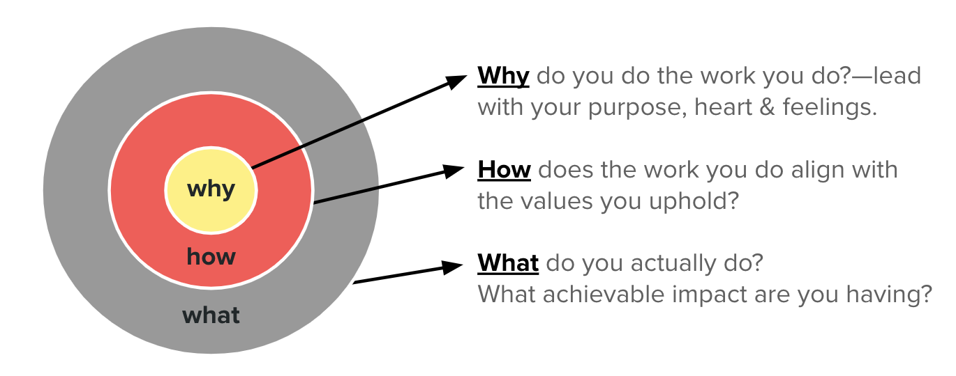
“People don’t buy what you do, they buy why you do it.”
Notes:
Focus on the impact your organisation has had on individual lives, rather than your outputs (i.e. your products or services). Think about one story that highlights what difference your organisation has made for someone. What’s something you’ve achieved that made you feel really proud about what you do?

Slide 6

Share with your neighbour
1. Introduce yourself and tell the story of the organisation you’re with today.
2. Get your neighbour’s perspective on your story and its importance!
Notes:
Get a new lens on things you may not have thought of before - gauge for their opinion on why they should care
We recommend doing this with other stakeholders that are already familiar with your organisation
Take the next 5 minutes to buddy up with your next neighbour or two and share the following:
Introduce yourself and the organisation you’re with today
Get the perspective from someone else

Slide 7
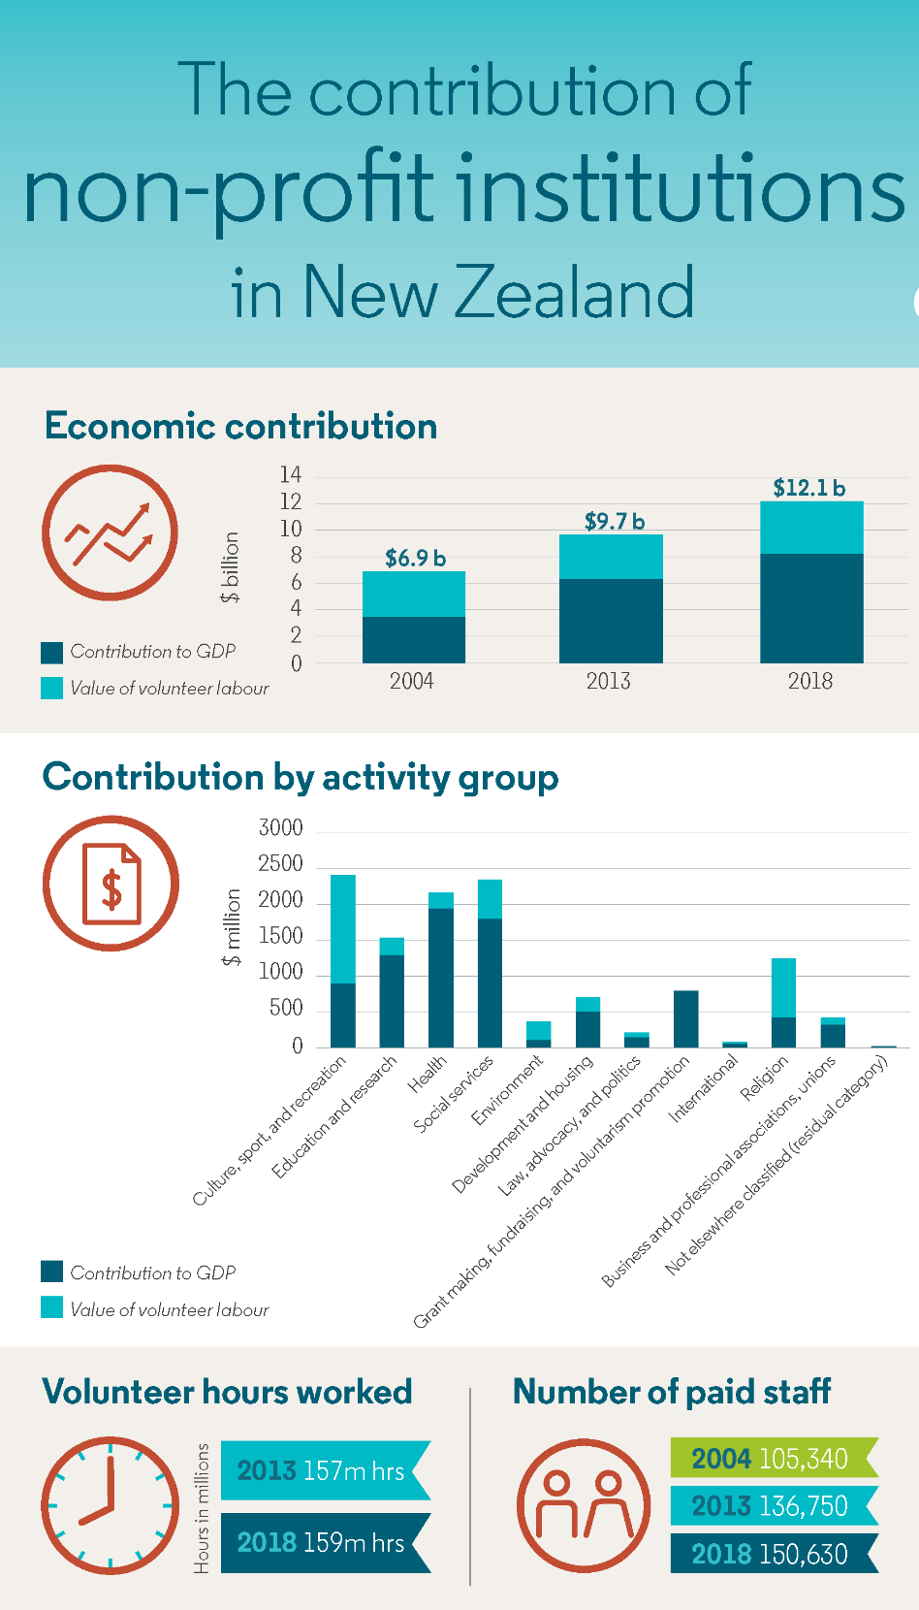
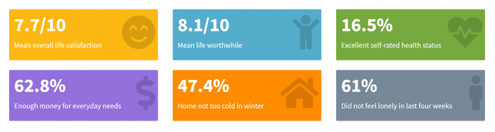
Use data and evidence
While data is not everything….well placed numbers and clearly presented data can provide a critical lens to understanding your work.
Notes:
Storytelling and narratives are not just about anecdotes and emotions. They also need to be backed up by data and evidence that support your claims and show your results. Use quantitative and qualitative data, such as statistics, indicators, surveys, interviews, testimonials, case studies, stories, photos, videos, or infographics. Make sure your data is accurate, relevant, and verifiable. Use data visualization tools to present your data in a clear and attractive way.
Examples of getting that evidence – surveys, interviews, engagement stats, etc. - how many people will benefit?
How else have you gathered these sorts of figures and for what? How did you use/share them meaningfully?

Slide 8

Be honest and transparent
Notes:
Storytelling and narratives are not meant to hide or sugarcoat your challenges, failures, or mistakes. They are meant to show how you dealt with them, what you learned from them, and how you improved your project. Be honest and transparent about your successes and shortcomings. Acknowledge your limitations, gaps, and risks. Explain your assumptions, methods, and sources. Share your challenges, failures, and learnings as opportunities for growth and improvement.
Be upfront about the challenges, failures and mistakes. This is a great opportunity to showcase your agility and resilience by showcasing how you overcame them

Slide 9
Keep it simple and concise
Readability matters! Prepare stories that are easy to digest.
Keep the message simple so your audience doesn’t have to guess what you’re telling/asking
Visually clean helps
Notes:
Storytelling and narratives do not mean that you have to write long and complex reports. In fact, you should aim to keep your communications simple and concise. Use clear and simple language that is easy to understand and follow. Avoid jargon, acronyms, and technical terms that may confuse or alienate your audience. Use short and simple sentences and paragraphs that are well-organized and coherent.

Slide 10

Alignment with your audience
Notes:
Different funders and stakeholders may have different expectations and preferences for your communications.
Some may want more details, some may want more numbers, others may want more stories. Some may want more formal language, others may want more conversational tone.
Know your audience - remember you have to reach their hearts and minds! Hearts is emotive - minds is the numbers. To make your communications more effective, tailor your story to your audience.
Also think about the way you reach them! Is it an email? In person? Social media? Etc.
When it comes to your stakeholders, talk about the funders key strategy areas and ensure alignment to those - Remember your job is to impress them so that they want to be on the journey with you.

Slide 11

Other things to consider
Notes:
Consider inviting your stakeholders along so they can see and feel what you and your organisation are all about and experience it first hand.
Stakeholders become advocates for your work!

Slide 12
Some great resources to help tell your story
Community Comms Collective: www.communitycomms.org.nz/resources/
Canva: www.canva.com/canva-for-nonprofits
Wix: www.support.wix.com/en/article/building-a-website-for-free
Mailchimp: www.mailchimp.com
DigitalBoost: digitalboost.business.govt.nz
Notes:
Community Comms Collective is gives a free communications boost to community organisations so their efforts go further with lots of helpful comms resources.
Canva is a free tool for designing posters, with some great templates and graphics on hand. The pro version has access for higher quality downloads of the designs, more free templates and graphics, and is free for organisations that are registered as a Charity with NZ Charities Services, Nonprofit with tax-exemption status with the Inland Revenue or a Donee Organisation.
Wix is an easy to use website builder that has basic hosting for free
Mailchimp is an email newsletter platform that is free for sending up to 1,000 emails/month
DigitalBoost is a completely free government-funded tool to help Kiwi businesses with instructional videos and diagnostic tools for digital communications such as social media and websites, and many other digital tools for operations.

Slide 13

Any pātai?
Notes:
Come talk to us - happy to help. Now go take some time to go tell your story to the funders here today!

